Slide 1

The Number System
Presented By:
Elizer Ponio Jr. Department of Computer Science
College of Computing and Information Technologies

Slide 2
Outline
Representing Information
Binary Representation
Text, Images and Sound

Slide 3

Representing Information
Imagine your friend asked if you could hang out later.
This is a yes-no question and so one way you could respond is by saying "Yes" or "No".
This is one possible pair of responses you could use so your friend can understand, but there are many more possible pairs.

Slide 4
Representing Information
List as many different ways that you could write, say, or represent the answer to a "Yes-No" question.

Slide 5
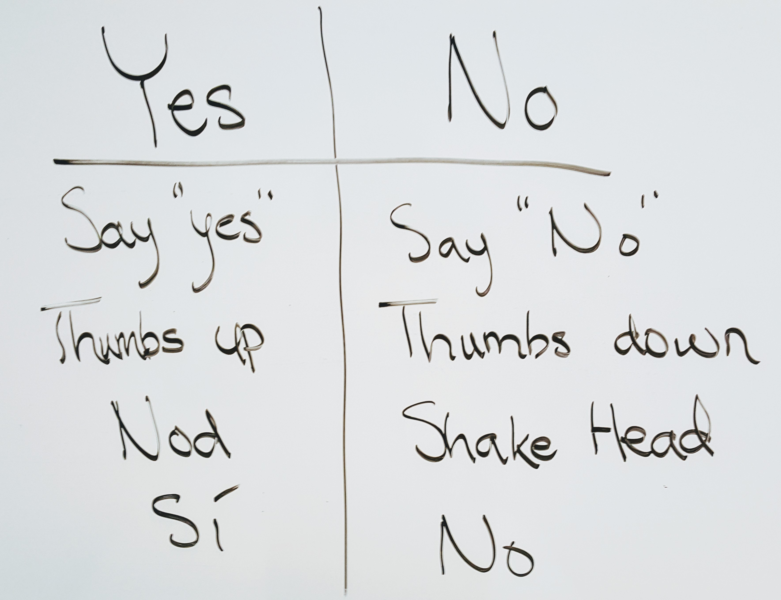
Each row in our table is a different "system" but they all represent the same information. Why do you think we have so many different systems to represent the same information?
Notes:
This conversation sets you up to make another important point, that different systems are created for different contexts

Slide 6
Representing Information
What we're seeing here is that there are many "systems" that we could choose to use to represent the same information.
The information of a "Yes" could be a head nod or a thumbs up, and a "No" might be a minus sign or a down arrow.

Slide 7

Representing Information
As humans we have created a lot of systems because they are better or worse depending on the situation.
People speak many different languages. We have made a lot of systems because we want to communicate information in different situations.

Slide 8

Representing Information
Computer scientists care about systems for representing information because a computer does not understand the world the way humans do.
It needs to be given information using a system that takes into account the fact that it's just a box of wires.

Slide 9
Representing Information
Computers need systems to represent information too, and today we're going to start exploring what kinds of systems a computer would need to represent information.

Slide 10

Outline
Representing Information
Binary Representation
Text, Images and Sound

Slide 11
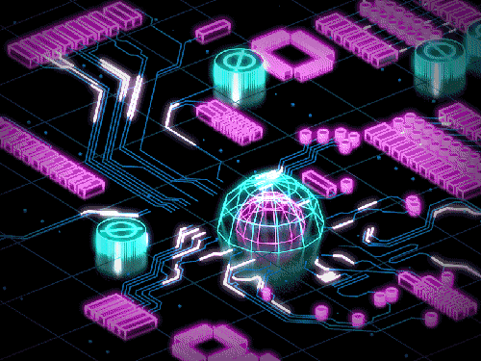
Binary Representation
Modern computers are electronic devices filled with a lot of tiny wires and circuits.
These wires and circuits carry electricity and at any moment they can be ON or OFF.
All the information we use on a computer like documents, videos, and pictures, eventually need to be translated down into these ON and OFF signals.

Slide 12

Binary Representation
How do you represent information using electricity?

Slide 13


Binary Representation
A binary system is a representation of information using only two options,

Slide 14
Binary Representation
1 | 0
TRUE | FALSE
YES | NO
ON | OFF
It is called a binary system because it can only represent two states of information. In a binary system, a bit can store either ON or OFF
A bit is the smallest piece of information a computer can store.

Slide 15
Binary Representation
1 bit
0
1
2 bits
0 | 0
0 | 1
1 | 0
1 | 1
3 bits
0 | 0 | 0
0 | 0 | 1
0 | 1 | 0
0 | 1 | 1
1 | 0 | 0
1 | 0 | 1
1 | 1 | 0
1 | 1 | 1
With more bits, we can represent more complex information

Slide 16
Binary System and Decimal System
DECIMAL
0 | 1 | 2 | 3 | 4
5 | 6 | 7 | 8 | 9
BINARY
0 | 1

Slide 17
Decimal Number System
1 | 9 | 9 | 0
Thousand
Hundred
Ten
One
For each bit, we increase it by a factor of 10.

Slide 18
Binary Number System
1 | 0 | 1 | 0
Eight
Four
Two
One
For each bit, we increase it by a factor of 2.

Slide 19

Binary Number System
1 | 0 | 0 | 1
Eight
Four
Two
One
(1 x 8) + (0 x 4) + (0 x 2) + (1 x 1)

Slide 20
Binary Number System
Any number can be represented with a

Slide 21
Binary Number System
With 8 bits, we can store any number between
0
0 | 0 | 0 | 0 | 0 | 0 | 0 | 0
and 255
1 | 1 | 1 | 1 | 1 | 1 | 1 | 1

Slide 22
Binary Number System
With 32 bits, we can store any number between
0
0 | 0 | 0 | 0 | 0 | 0 | 0 | 0 | 0 | 0 | 0 | 0 | 0 | 0 | 0 | 0 | 0 | 0 | 0 | 0 | 0 | 0 | 0 | 0 | 0 | 0 | 0 | 0 | 0 | 0 | 0 | 0
to over 4 billion
1 | 1 | 1 | 1 | 1 | 1 | 1 | 1 | 1 | 1 | 1 | 1 | 1 | 1 | 1 | 1 | 1 | 1 | 1 | 1 | 1 | 1 | 1 | 1 | 1 | 1 | 1 | 1 | 1 | 1 | 1 | 1

Slide 23
Outline
Representing Information
Binary Representation
Text, Images and Sound

Slide 24
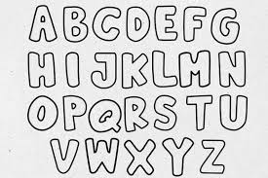

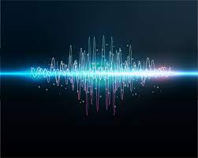
Text, Image and Sound
Text, Images and Sound can all be represented with numbers

Slide 25
Text in Binary
One of the most popular binary systems for representing letters is called ASCII
Each symbol or letter in ASCII has an equivalent binary value.

Slide 26
Text in Binary
Symbol | Decimal | Binary
A | 65 | 1000001
B | 66 | 1000010
C | 67 | 1000011
D | 68 | 1000100
E | 69 | 1000101
F | 70 | 1000110
G | 71 | 1000111
H | 72 | 1001000
I | 73 | 1001001
J | 74 | 1001010
K | 75 | 1001011
L | 76 | 1001100
M | 77 | 1001101
N | 78 | 1001110
O | 79 | 1001111
P | 80 | 1010000
Q | 81 | 1010001
R | 82 | 1010010
S | 83 | 1010011
T | 84 | 1010100
U | 85 | 1010101
V | 86 | 1010110
W | 87 | 1010111
X | 88 | 1011000
Y | 89 | 1011001
Z | 90 | 1011010

Slide 27


Images in Binary
All photos, videos and computer generated graphics that you see in a screen are all made up of tiny dots called pixels.

Slide 28
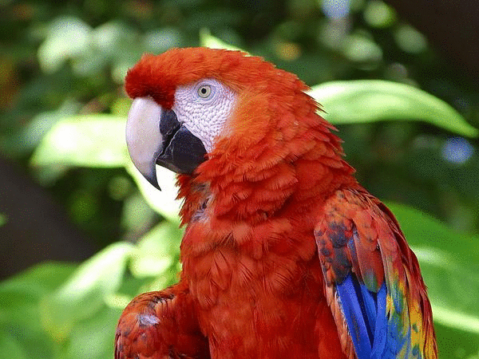
Images in Binary
An image can be made up of millions of billions of pixels.
The quality of an image depends on the number of pixels it has
The higher the pixel count, the sharper the image will be

Slide 29
Images in Binary
253 | 78 | 141
Red | Green | Blue
Each pixel has a color, and each pixel can be represented by a number

Slide 30

Images in Binary
Each pixel has a color, and each pixel can be represented by a number

Slide 31

Encode and Decode
When we change the way that we represent information so that it's easier for a computer to use, we encode that information.
When we change it back so that it's easier for a human to understand, we decode that information.

Slide 32
Summary
Encode - change how information is represented so that it can be read by a computer
Decode - change how information is represented so that it can be read by a person
ASCII - a popular system for representing text in binary
Binary System - a way of representing information using only two options
Bit - a single piece of binary information

